Slide 1
COMPILER DESIGN PROJECT C YOUR CODE (LEXICAL ANALYSIS)
SUBMITTED BY :
VISHVESH BHARDWAJ (RA2011026010109)
RAGHAV KAPOOR (RA2011026010117)

Slide 2
INTRODUCTION
The development of a website that allows developers to input their code and see the output of what the compiler would produce is an excellent tool for developers. As software development becomes increasingly complex, the ability to test code and identify potential errors before deploying it is critical. This tool provides developers with a convenient way to quickly and efficiently test their code without the need to install and configure a complete development environment.
Additionally, this tool is also useful for teaching programming. Beginners can use the tool to learn the basics of programming without the need to install and configure a development environment. The tool provides an easy-to-use interface that allows users to write code, see the output of what the compiler would produce, and make changes as needed. The feedback provided by the tool is immediate and clear, which helps beginners quickly identify and correct errors.

Slide 3
PROBLEM STATEMENT
As a software developer, we might have encountered situations where you want to test your code against different compilers, or we might have to compile your code on different platforms. But it can be time-consuming and challenging to set up different compilers and platforms to compile your code manually. This is where the tool you have developed comes in handy. The tool allows developers to input their code and see the output of what the compiler would produce without worrying about installing and configuring different compilers and platforms. With your tool, developers can quickly test their code against different compilers and platforms without leaving their development environment. This tool can also be beneficial for developers who are just starting with programming, as they can see how their code is being compiled and understand the different stages of the compilation process, such as lexical analysis and intermediate code generation. Moreover, the tool can help developers to identify and fix errors in their code during the development phase, making it easier for them to deliver bug-free code. Hence, the tool can save developers a lot of time and effort by providing them with a convenient and efficient way to test their code against different compilers and platforms, and help them deliver high-quality code.

Slide 4
OBJECTIVES
Developed a website that allows developers to input their code and see the output of what the compiler would produce.
Implemented a lexical analyzer, intermediate code generation, and quadruple triple in Python.
Used ReactJS as frontend and NodeJS with Express JS as backend.
When the server API is called, based on the part of the compiler selected from drop down, that part's shell script is executed and stored into a buffer.
Utilized Linux file directory to store the buffer and read it for the response to the frontend REST API and display the output on the website.

Slide 5
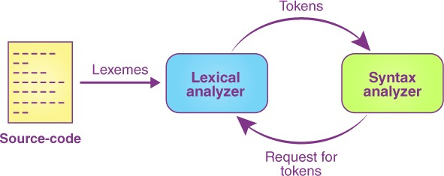
LEXICAL ANALYSIS

Slide 6
Lexical analysis is the first phase of the compilation process in which the input source code is scanned and analyzed to generate a stream of tokens that are subsequently used by the compiler in the later stages of the compilation process.
The process of lexical analysis is also known as scanning, and the component of the compiler that performs this task is called a lexer or a tokenizer. The primary goal of lexical analysis is to identify the individual lexical units (tokens) of the source code, such as keywords, identifiers, literals, operators, and punctuation marks, and produce a stream of tokens that can be processed by the compiler's parser.
The process of lexical analysis involves several steps. The first step is to read the source code character by character and group them into lexemes, which are the smallest meaningful units of the programming language. Next, the lexer applies a set of rules or regular expressions to identify the lexemes and classify them into different token types.
During this process, the lexer also discards any comments or white spaces that are not significant to the language's syntax. For example, the lexer would ignore any spaces, tabs, or newlines in the source code and focus only on the meaningful tokens that make up the language's syntax.

Slide 7
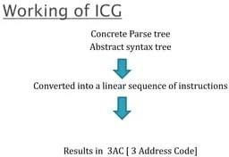
INTERMEDIATE CODE GENERATION

Slide 8
Intermediate code generation is a crucial phase in the process of compiling a programming language. Its purpose is to translate the source code into an intermediate language representation that is closer to machine code and can be easily optimized and translated into executable code.
During intermediate code generation, the compiler analyses the source code and creates a simplified version of it, typically in the form of a set of instructions or statements in a lower- level language. This intermediate code serves as a bridge between the high-level source code and the low-level machine code.
The intermediate code is usually designed to be independent of the hardware and operating system on which the code will eventually run, making it easier to port the code to different platforms. It also allows the compiler to perform optimizations that can improve the performance of the generated code, such as dead code elimination and constant folding.
Some examples of intermediate code representations are Three-Address Code (TAC), Quadruple Code, and Intermediate Representation (IR). These representations are usually simpler and more concise than the original source code, making it easier for the compiler to analyze and optimize them. Once the intermediate code is generated, the compiler can then proceed to the next phase, which is code optimization and code generation.

Slide 9
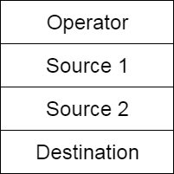
QUADRUPLE

Slide 10
In compiler design, a quadruple is a data structure used to represent an executable instruction or operation in an intermediate representation of a program. It contains four fields, namely the operator or instruction to be performed, the addresses of the operands, and the result. The quadruple is named as such because it has four fields. The operator field specifies the operation or instruction to be performed, such as "add", "subtract", "multiply", "divide", "assign", and so on. The operands and result fields contain memory addresses for the variables or memory locations that contain the values involved in the operation. The quadruple is a simple and uniform representation that can be used during code optimization and code generation phases of the compiler. It can be easily translated into assembly language or machine code.
Quadruples are a common intermediate representation in compilers because they provide a compact and uniform representation of executable instructions. They can be used to represent a wide range of operations, including arithmetic and logical operations, memory accesses, and control flow instructions. Quadruples are often generated during the semantic analysis phase of a compiler, where the compiler checks the syntactic and semantic correctness of the input program.

Slide 11
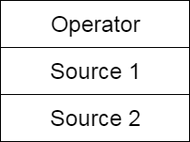
TRIPLE

Slide 12
In compiler design, triples are a common data structure used to represent three-address code, which is an intermediate representation of a program. Three-address code consists of instructions that have at most three operands and one result. The use of three-address code simplifies the analysis and optimization of the program. The triple data structure represents one line of the three-address code and consists of three fields: the operator, the first operand, and the second operand. The third field is used to store the result of the operation.
The use of triples is beneficial in optimizing the code because it can simplify the identification of redundant computations and remove them. It can also help to improve code efficiency by allowing the compiler to rearrange code instructions for better performance. For example, the triple data structure can be used to implement common subexpression elimination, where the compiler identifies identical expressions that are computed multiple times and replaces them with a single computation. This optimization can lead to a significant reduction in the number of instructions executed and, therefore, an improvement in program performance.
Triples are often generated during the code generation phase of the compiler, where the compiler translates the intermediate representation of the program into machine code or assembly language. The use of triples can make this translation more straightforward and efficient by simplifying the representation of the program.

Slide 13
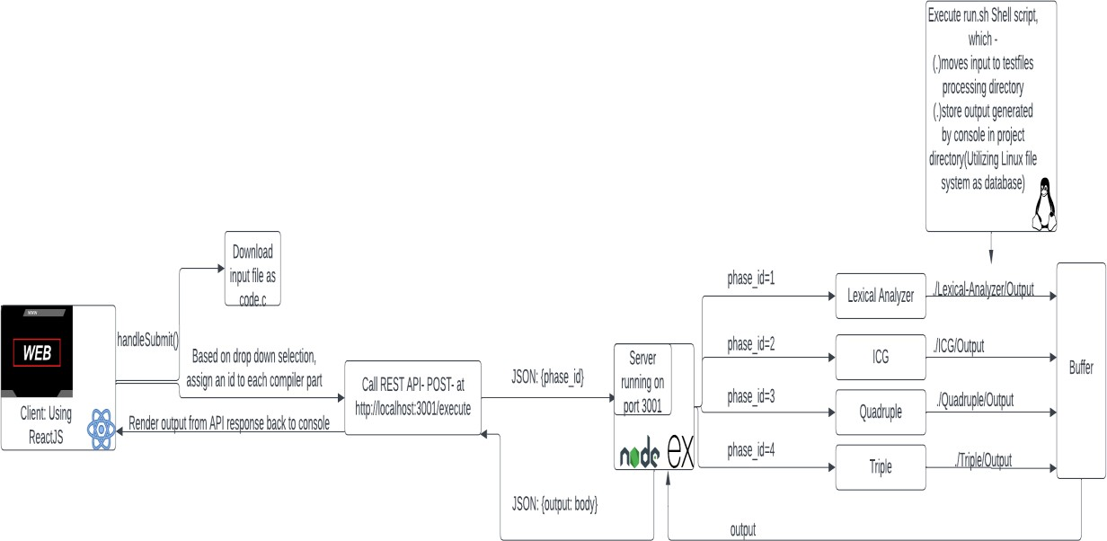
ARCHITECTURE DIAGRAM

Slide 14
The project consists of several components that work together to achieve its goal. The Front-end UI is responsible for presenting the user interface to the end-user, and it is built using ReactJS, which is a popular JavaScript library for building user interfaces. The REST API serves as the communication interface between the front-end UI and the back-end logic. It is implemented using a RESTful architecture that enables communication between different components using HTTP protocols. On the other hand, the back-end logic consists of several components, including the Lexical Analyzer and the Intermediate Code Generator (ICG). The Lexical Analyzer is responsible for analyzing the input source code and generating a stream of tokens, while the ICG is responsible for generating an intermediate code representation of the input source code. The Quadruple and Triple data structures are used to represent the intermediate code generated by the ICG, and they are also implemented as a part of the back- end logic. Overall, the project architecture involves the front-end UI, the REST API, and the back-end logic components, including the Lexical Analyzer, ICG, and data structures. Each component has a specific role and works together to achieve the project's objective.

Slide 15
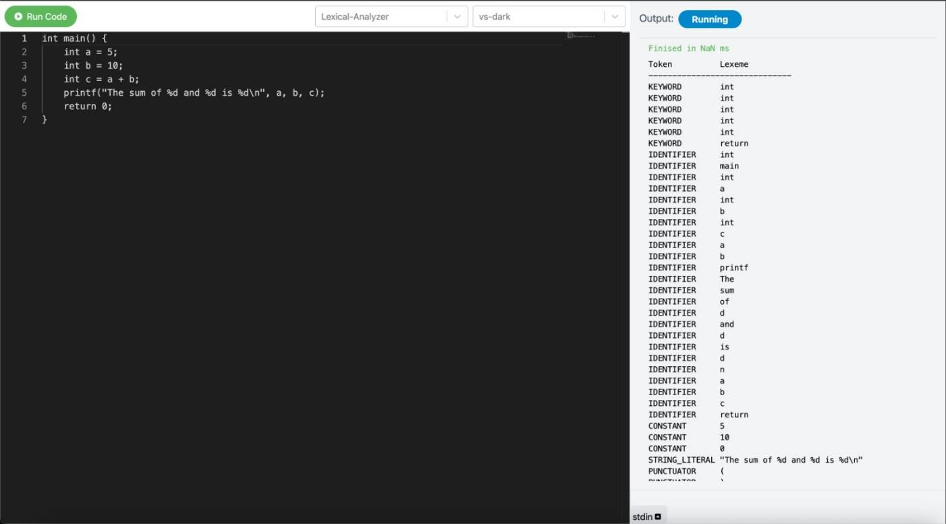
LEXICAL ANALYSIS

Slide 16
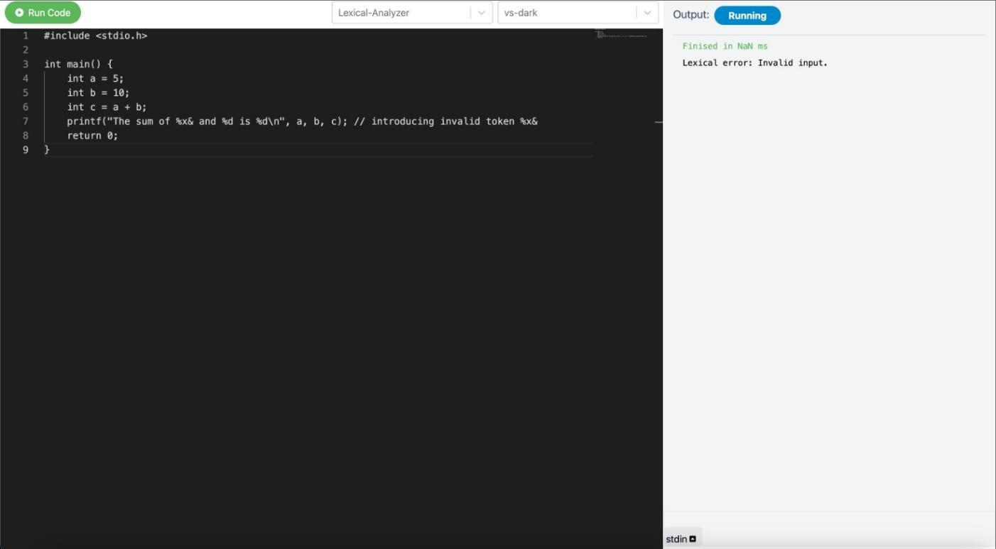
With Error Generation

Slide 17
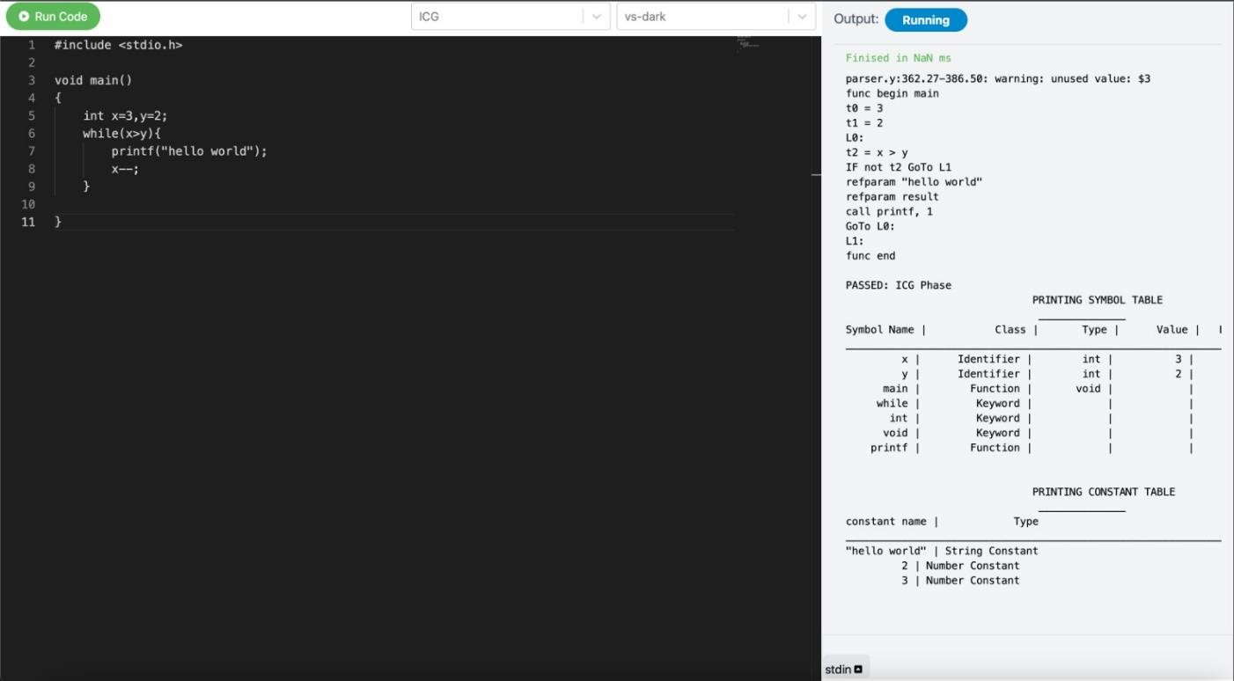
INTERMEDIATE CODE GENERATION

Slide 18

QUADRUPLE

Slide 19

TRIPLE

Slide 20
RESULT
The implementation of the phases of a compiler, including the lexical analyser, intermediate code generation, quadruples, and triples, has been successful in our project. The integration of modern web technologies, such as React JS and Node JS, has made the compiler more accessible to a wider range of users. Our compiler can effectively translate source code into executable code, making it a useful tool for developers and programmers. Through the development process, we encountered various challenges, such as ensuring the accuracy of the intermediate code generation process, but we were able to overcome these challenges through careful planning and testing. Overall, our project demonstrates our proficiency in compiler development and our ability to apply the concepts and tools learned in class to real-world applications. We believe that our compiler has the potential to be a valuable resource for the programming community and we are excited to see how it will be used in the future.

Slide 21
CONCLUSION
In conclusion, the development of a compiler that implements the various phases of the compilation process has been a challenging and rewarding experience. Through the implementation of the lexical analyser, intermediate code generation, quadruples, and triples, we have gained a deeper understanding of the inner workings of compilers and the importance of each phase in the compilation process. The integration of modern web technologies has made the compiler more user-friendly and accessible to a wider range of users. We believe that our compiler has the potential to be a valuable resource for developers and programmers, and we look forward to seeing how it will be used in the future.
The development process has also taught us valuable lessons about software engineering and project management. We learned the importance of careful planning, testing, and documentation in ensuring the success of a project. Additionally, we discovered the importance of communication and collaboration in a team setting, and how effective teamwork can lead to more efficient and effective outcomes.
Overall, our project has been a valuable learning experience that has allowed us to apply the concepts and tools learned in class to a real-world application. We are proud of what we have accomplished and look forward to applying our newfound knowledge to future projects and endeavors.

Slide 22


